Slide 1
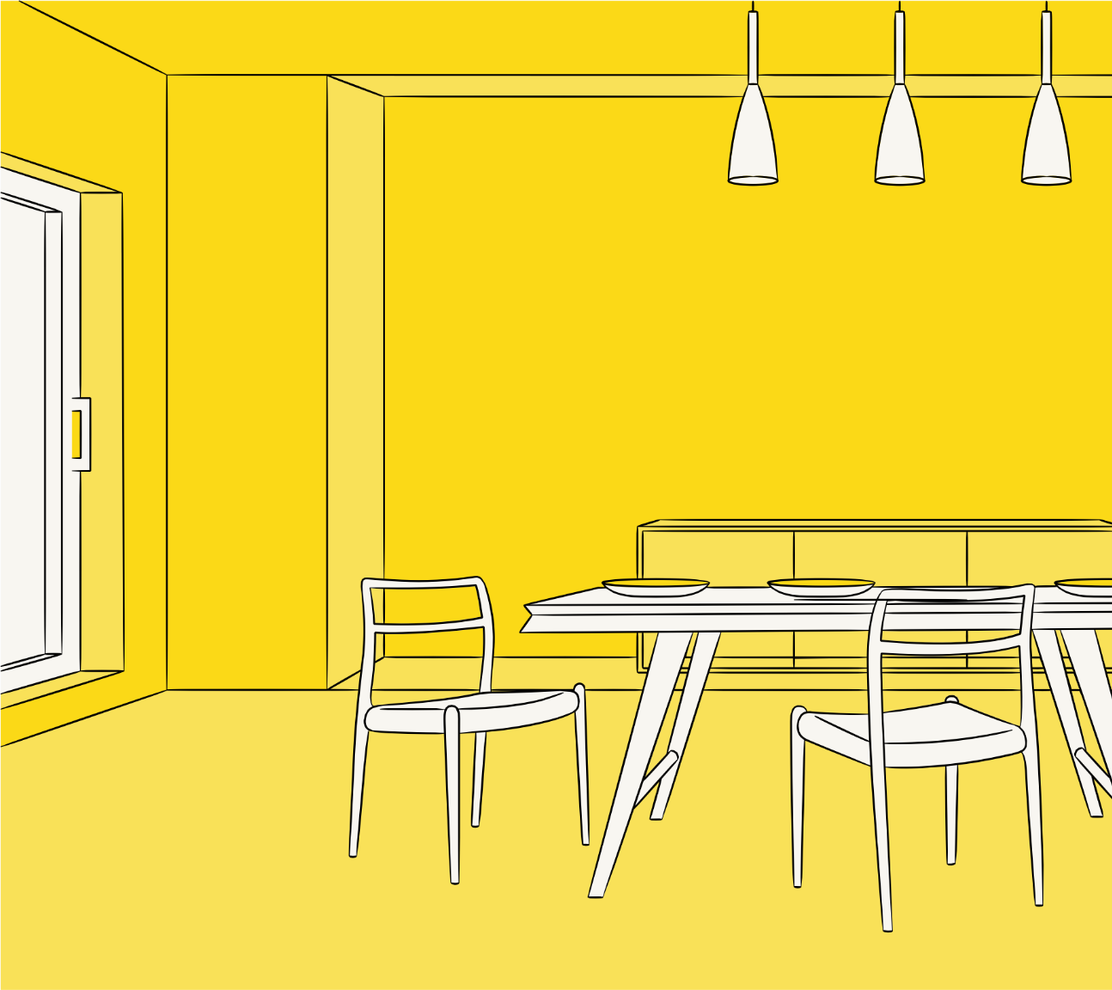
ProFab - Final Presentation
Smart Bin
Volodymyr
William

Slide 2
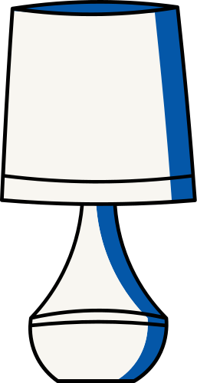
CONTENTS
Problem & Vision
Proposed Prototype
Implementation
Demo
Limitations
Remaining Challenges

Slide 3

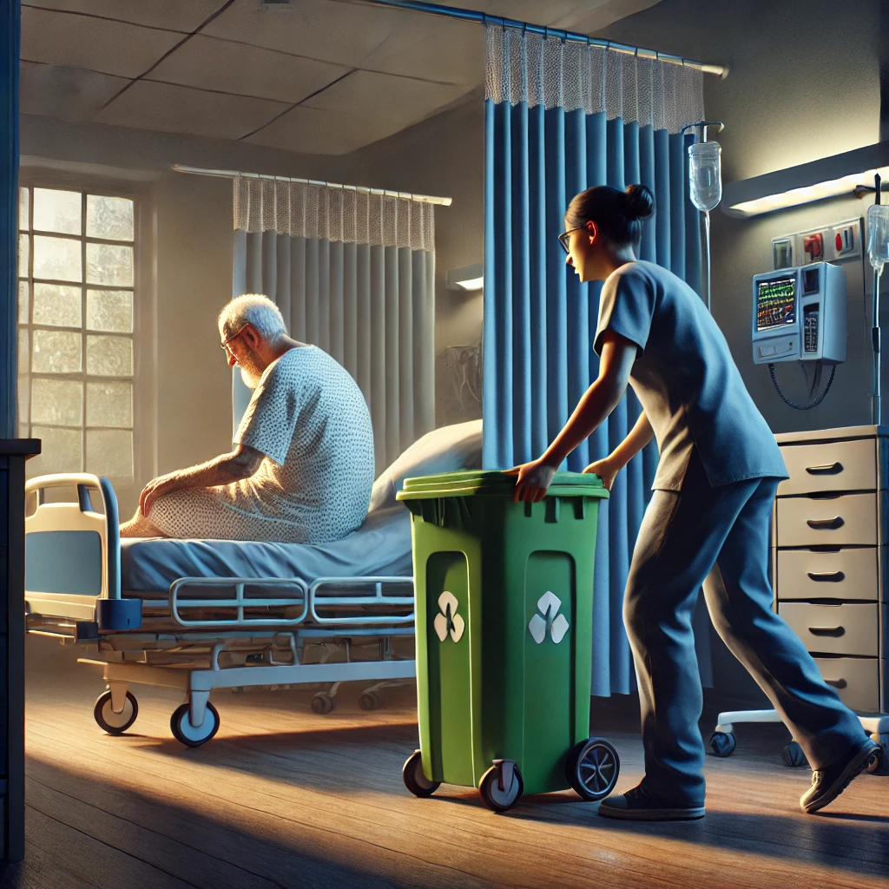
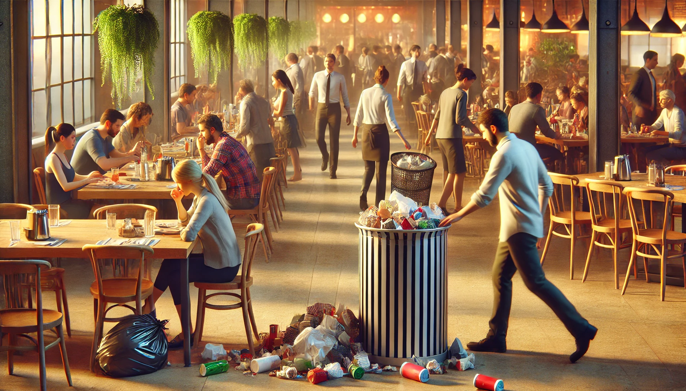
Problem

Slide 4
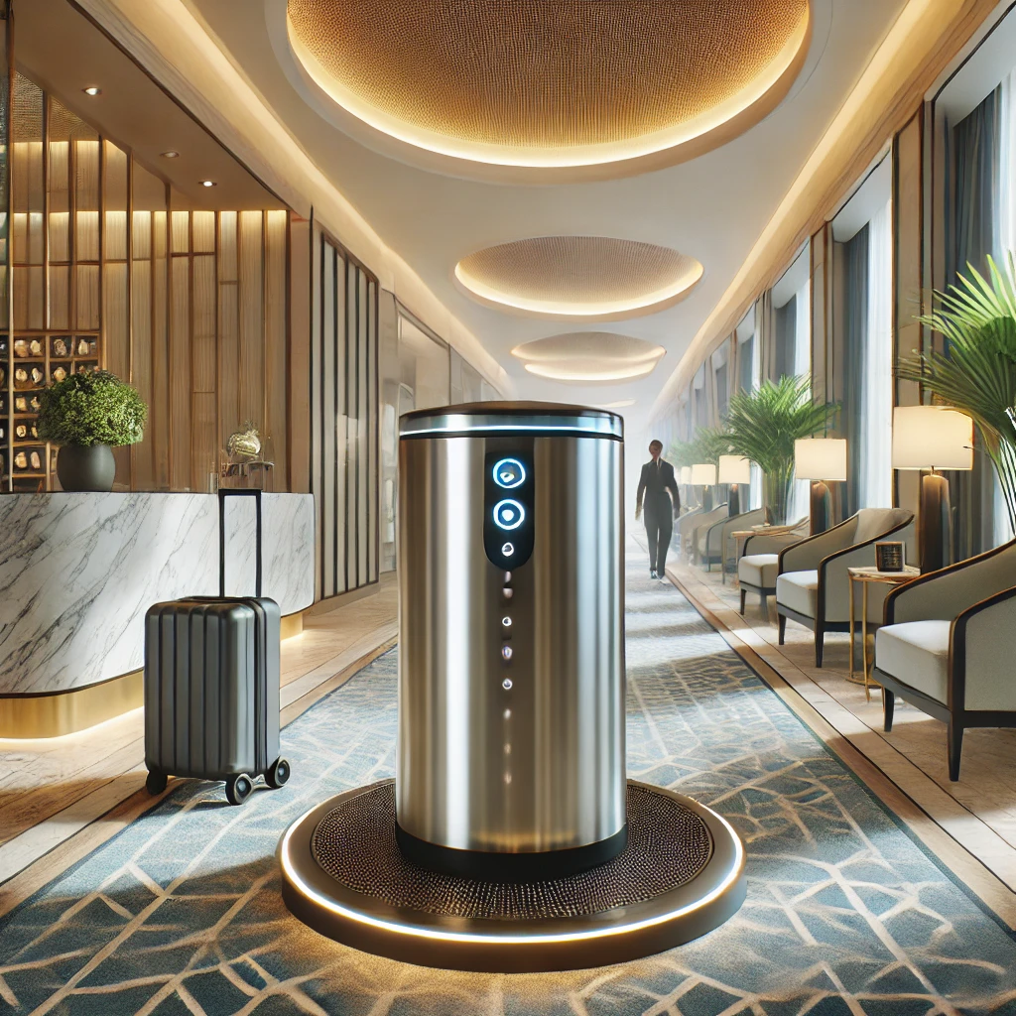
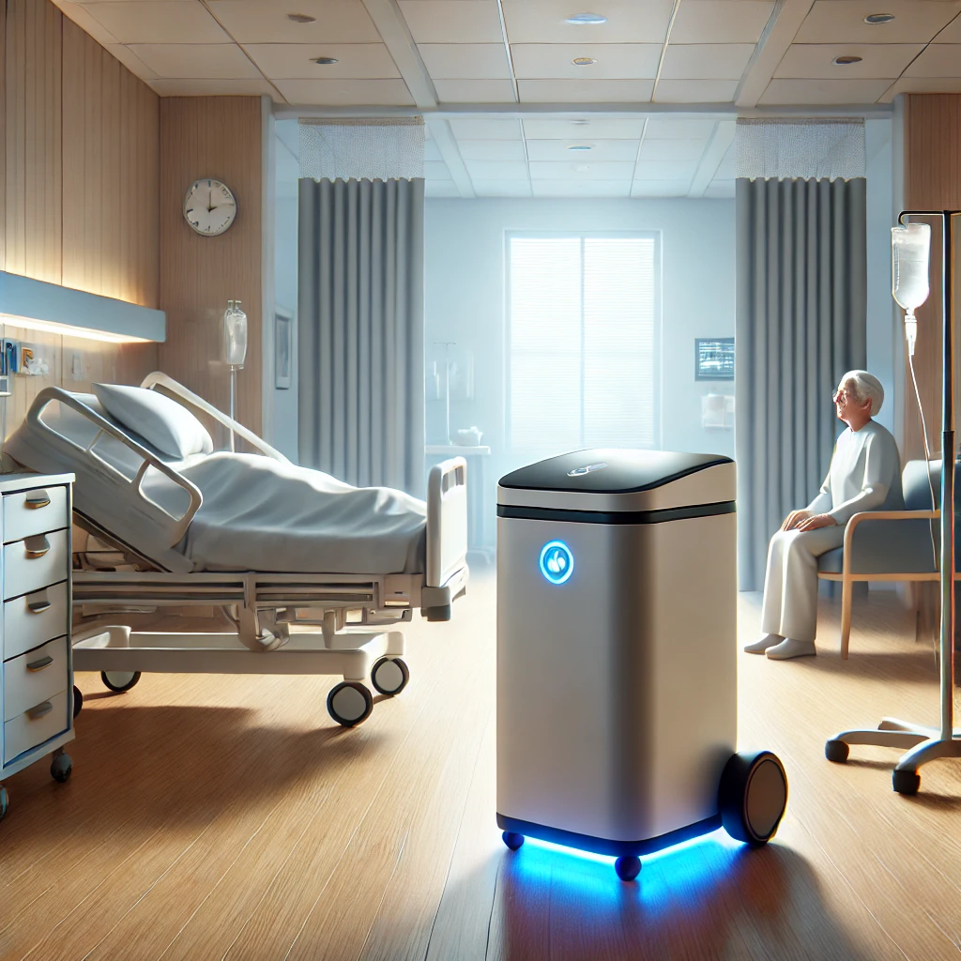
Vision
Lobby
patrol public spaces
easy way to discard trash for customers
2. Hospital
Accessibility for Patients with Limited Mobility
Contactless Waste Collection

Slide 5
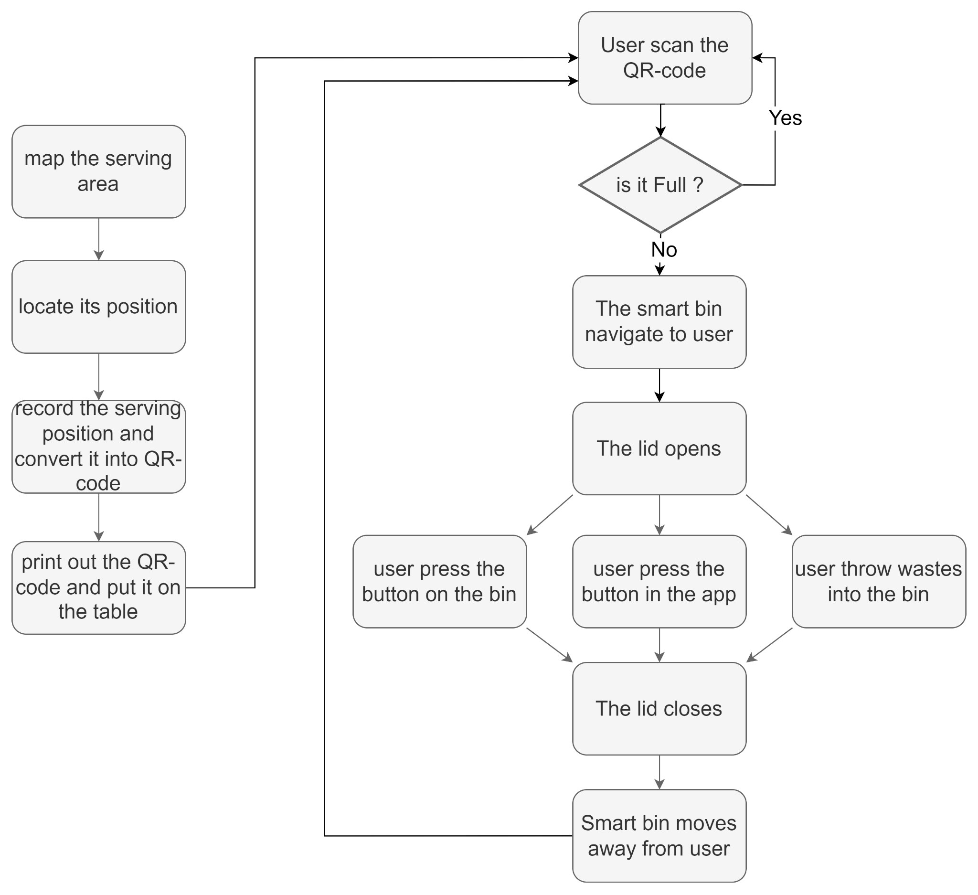
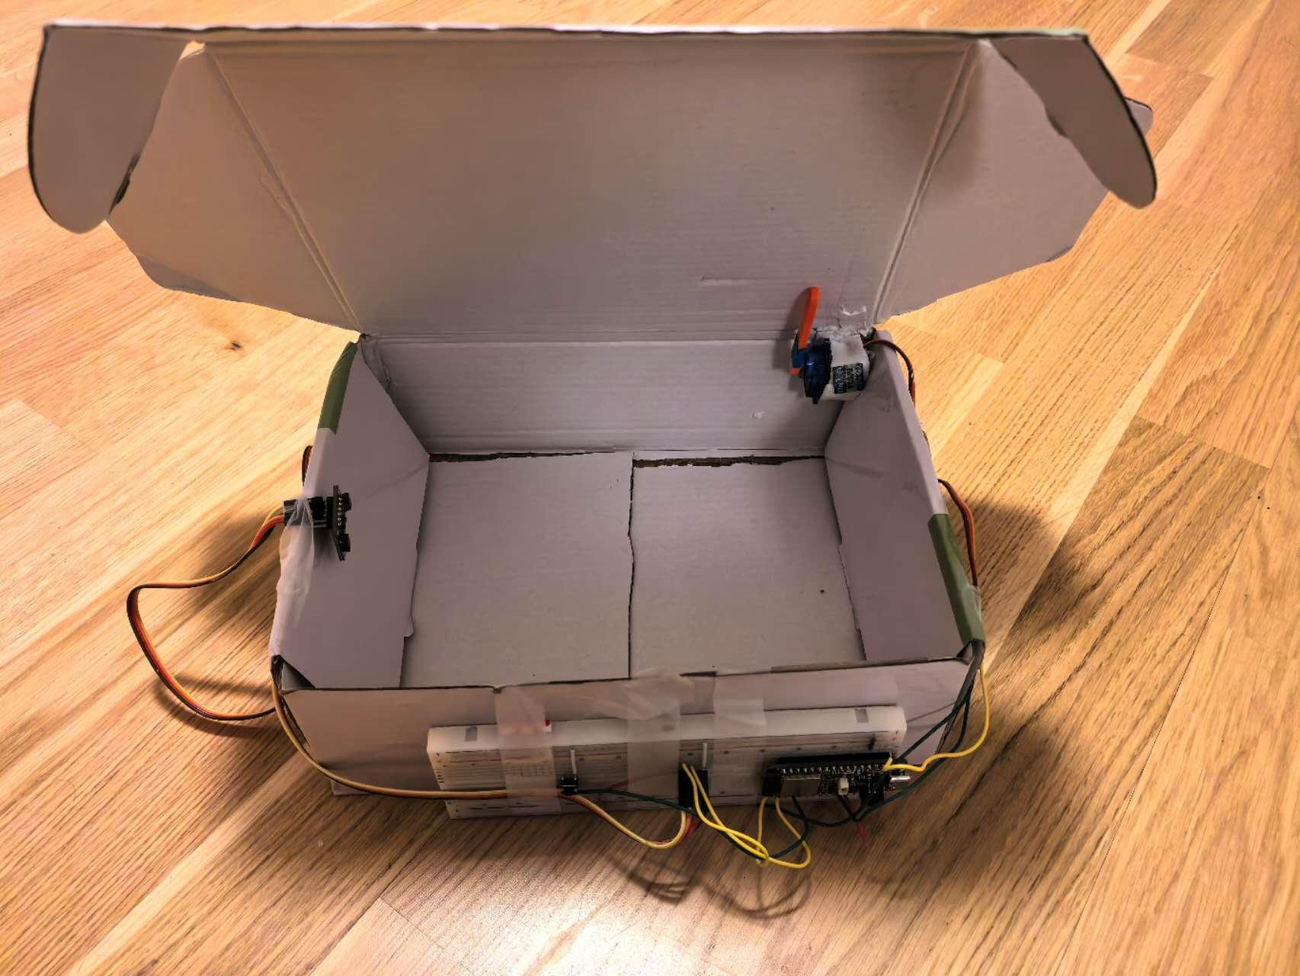
Proposed
Prototype

Slide 6
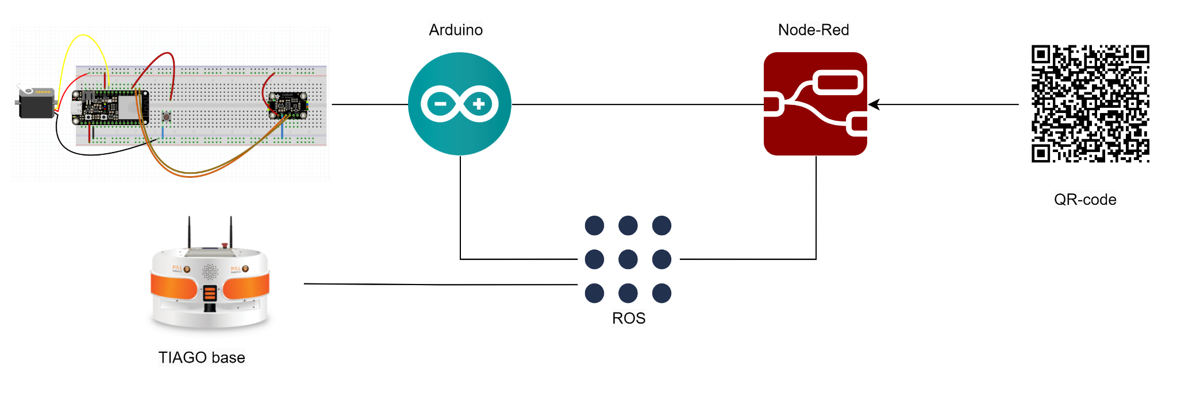
Architecture

Slide 7
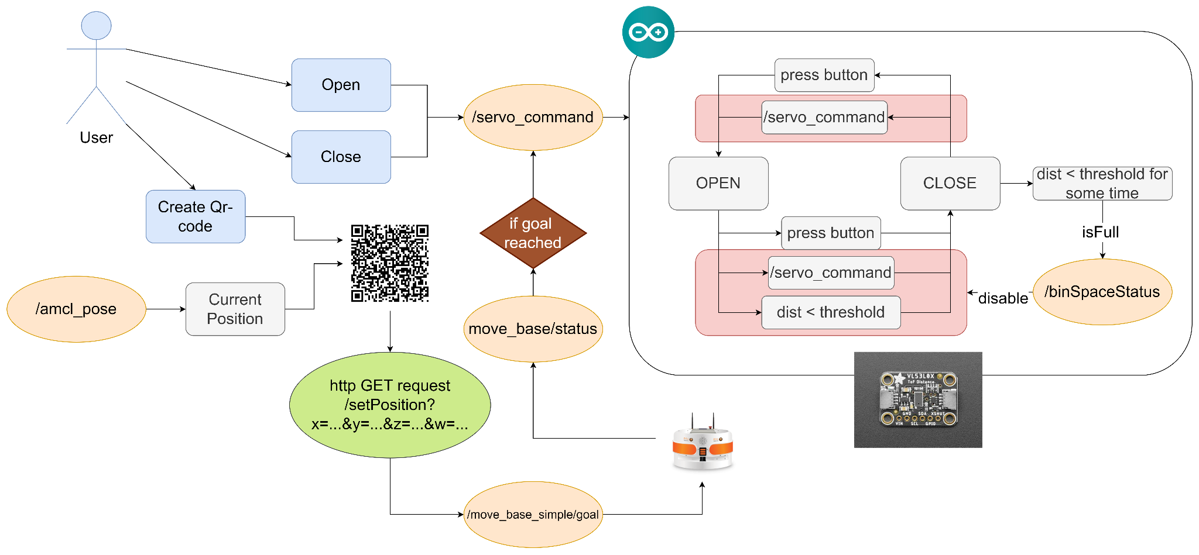
System Logic

Slide 8
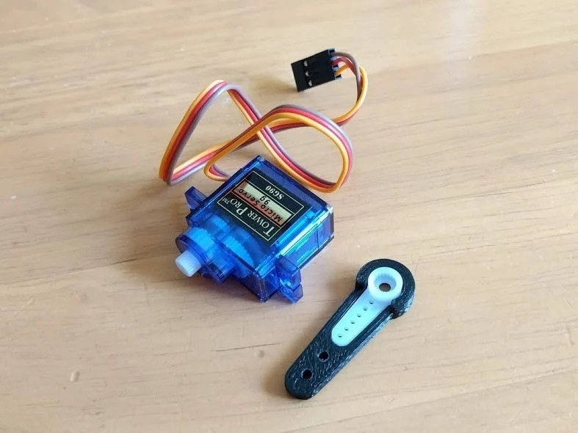
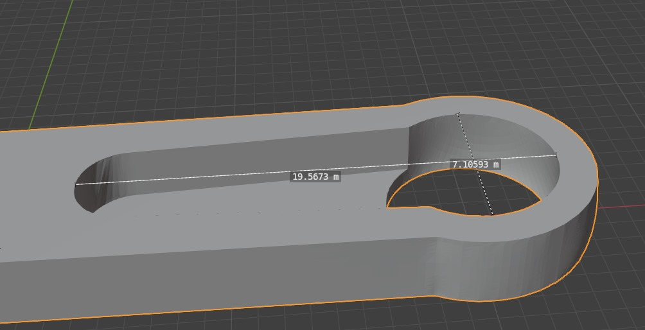
3D Printing

Slide 9
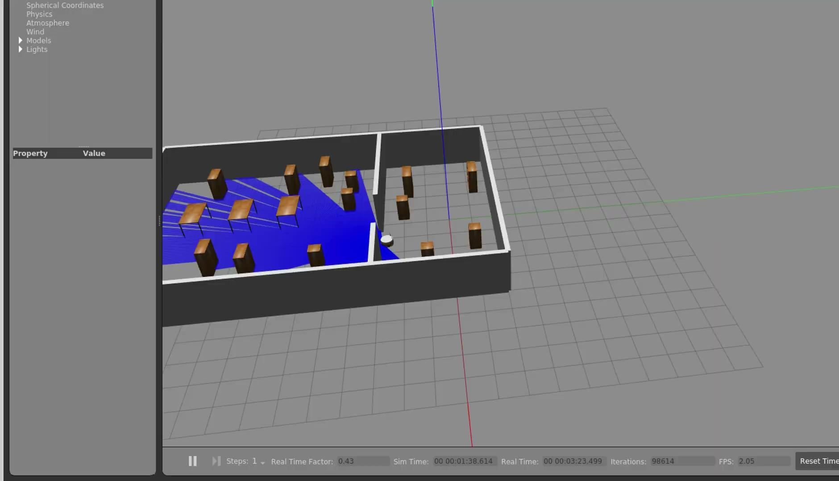
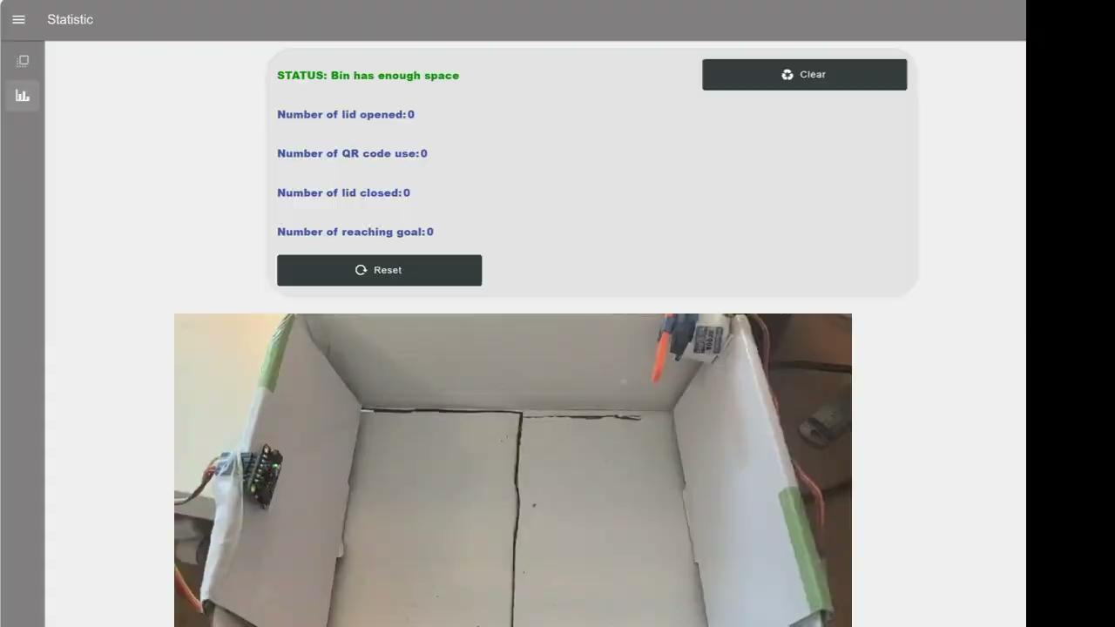
User Interface

Slide 10

Demo

Slide 11
Limitations of global project
The smart bin has to run on the flat plane
The environment is dynamic. There are people walking around the smart bin, which may cause collision and damage.
The smart bin needs to be charged periodically, which may cause significant consumption of electricity in large scale.
Multiple people summon the same smart bin, which may cause congestion.

Slide 12
Remaining Challenges
The distance sensor cannot cover all the area, leaving some blind zones where it cannot detect the garbage.
The lid mechanism is too simple and unstable
The 3d model is vulnerable to damage

Slide 13

THANK
YOU!

